Slide 1

Reproducible Data Science: How do you know if published scientific findings are replicable?
Adam Thomas
Data Science and Sharing Team, Intramural Research Program, NIMH

Slide 2







NIMH IRP Data Science and Sharing Team
Adam Thomas
Team Lead
Dustin Moraczewski
Data Scientist
Arshitha Basavaraj
Data Engineer
Jessica Dafflon
Data Scientist
Eric Earl
Data Scientist
Anthony Galassi
Software Engineer
Carl Harris
Post-bac IRTA
http://cmn.nimh.nih.gov/dsst

Slide 3
Poll #1
What percentage of peer-reviewed papers in the biomedical literature present results that can be replicated by another scientist in the same field?
> 80%
50-80%
20-50%
< 20%

Slide 4
Poll #1
What percentage of peer-reviewed papers in the biomedical literature present results that can be replicated by another scientist in the same field?
> 80%
50-80%
20-50%
< 20%

Slide 5

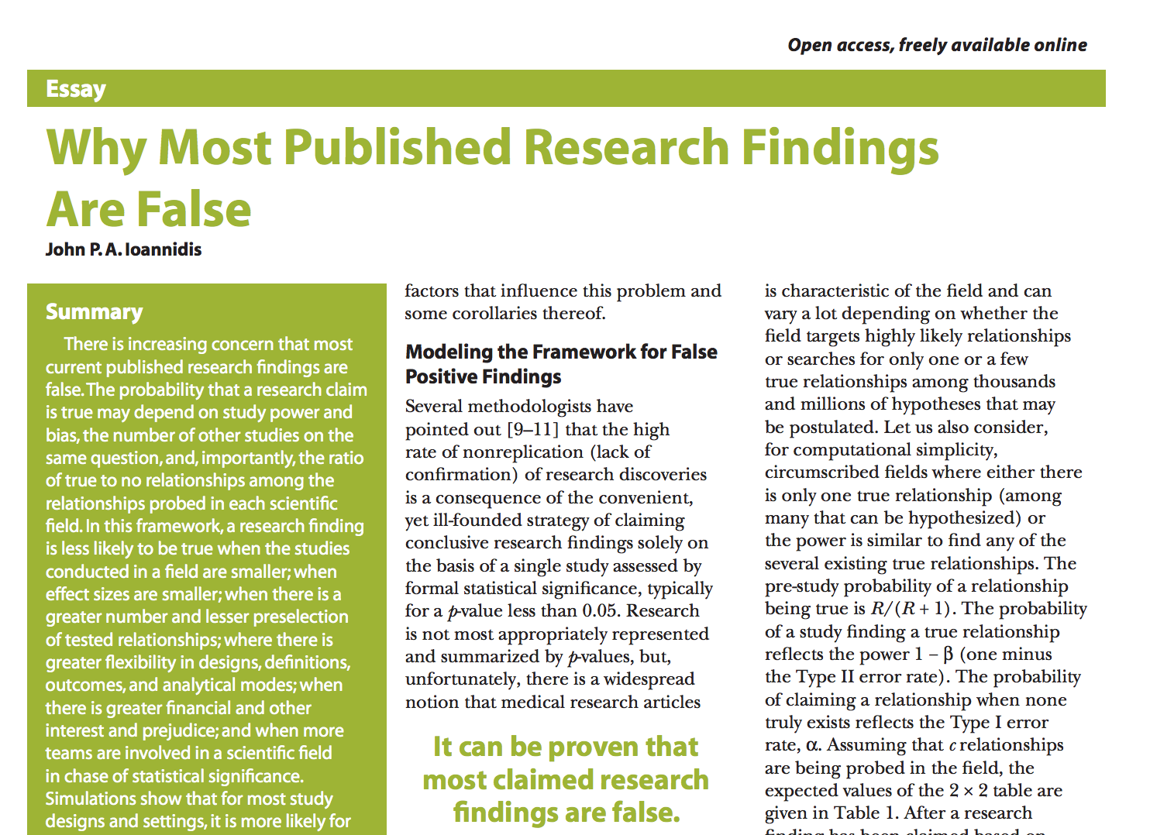

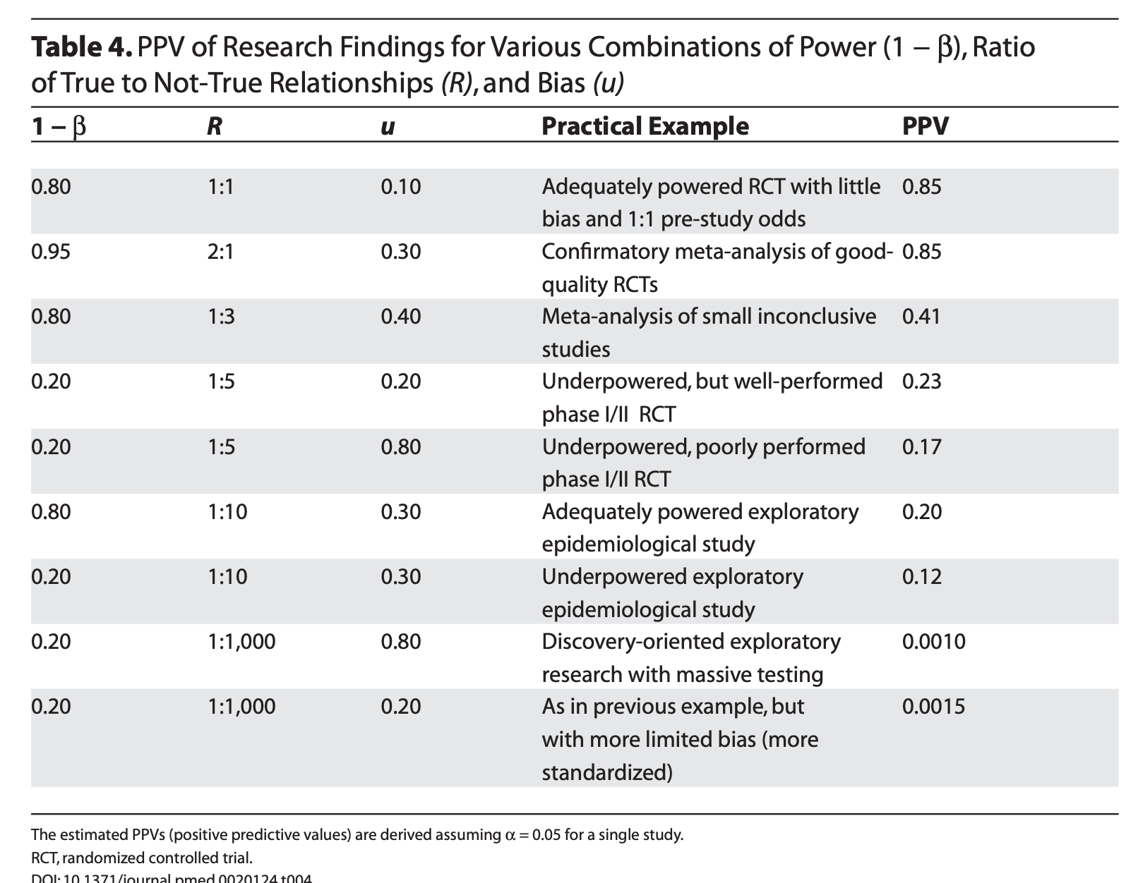
Less than 50%
Ioannidis on Reproducability Feb 2021, https://www.youtube.com/watch?v=L1-fNM0uJQA

Slide 6

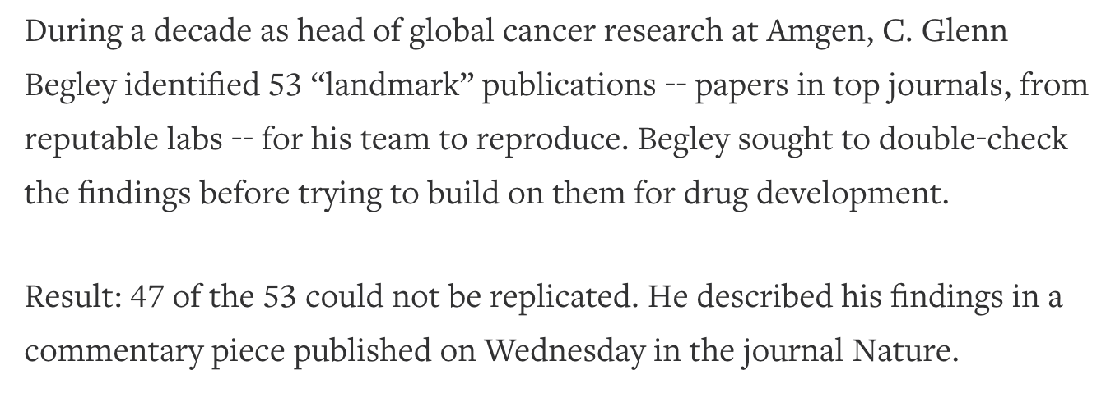
Reproducibility of Cancer Studies

Slide 7
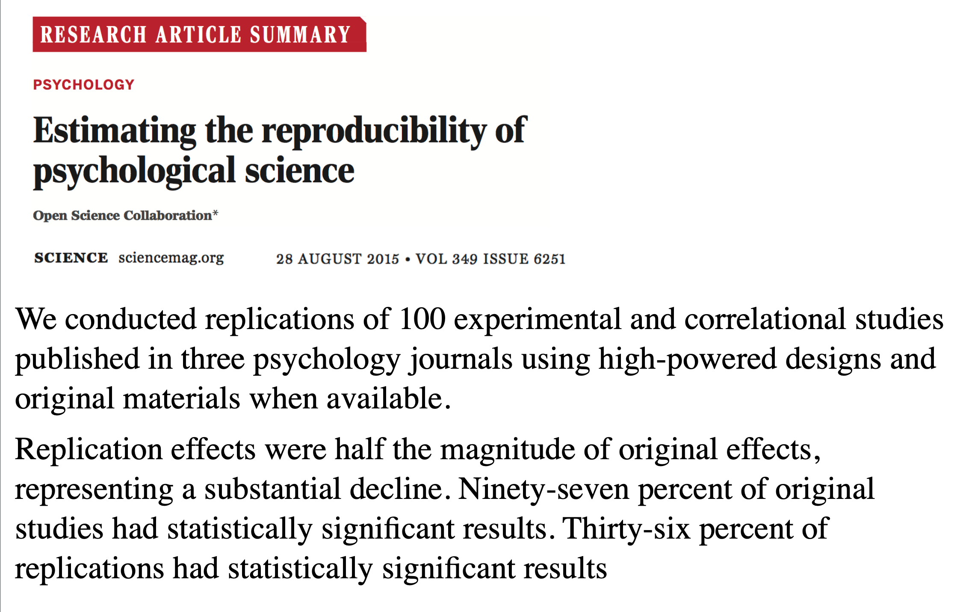
Reproducibility in Psychology
https://www.theatlantic.com/science/archive/2015/08/psychology-studies-reliability-reproducability-nosek/402466/
https://science.sciencemag.org/content/349/6251/aac4716

Slide 8
Poll Question #2
Papers published in prestigious journals are more likely to report reproducible findings.
True
False

Slide 9
Poll Question #2
Papers published in prestigious journals are more likely to report reproducible findings.
True
False

Slide 10
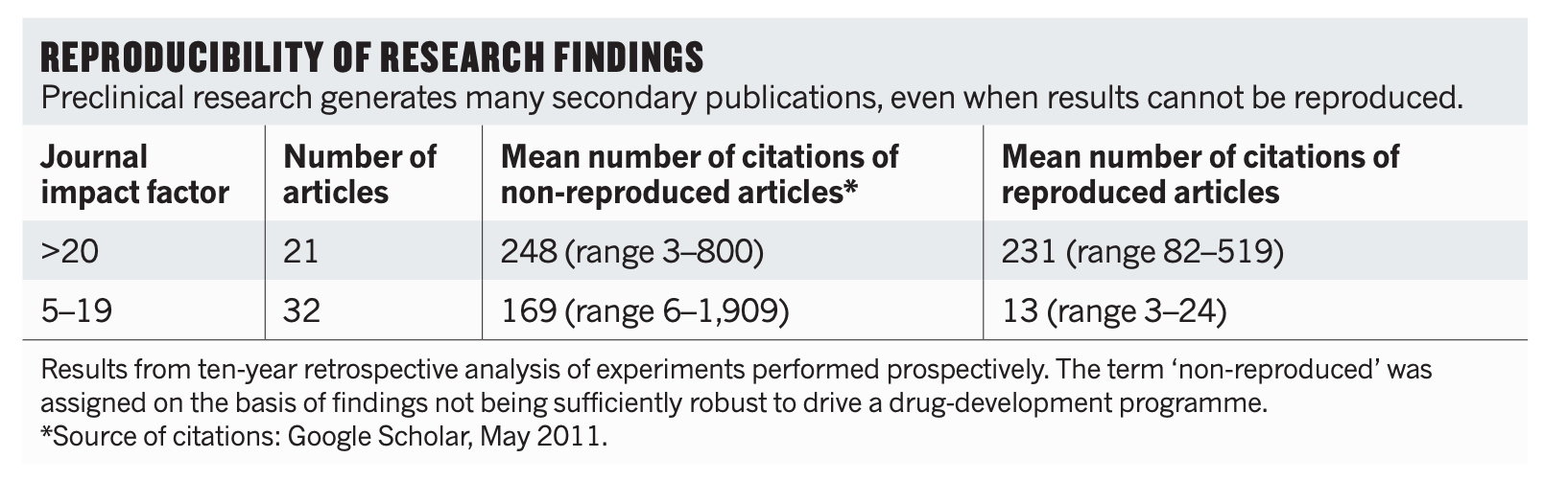
Reproducibility of Cancer Studies

Slide 11
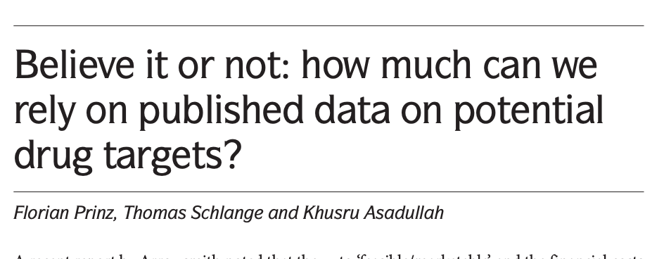


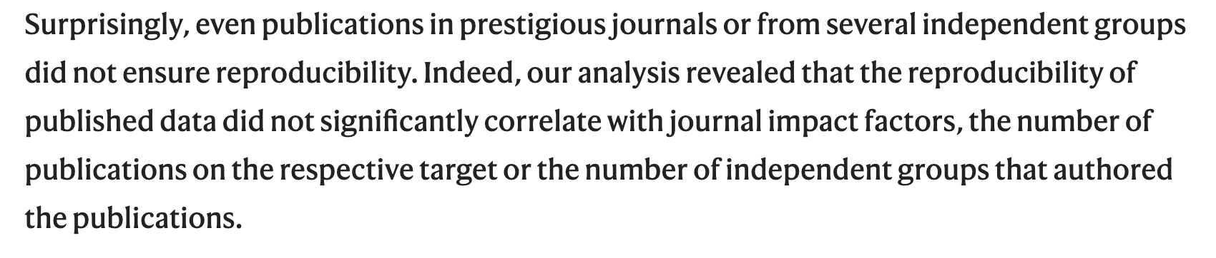
Reproducibility of Cancer Studies

Slide 12
Poll Question #3
Since Ioannidis's explosive 2005 paper, the field has become more vigilant, and the number of unreproducible findings published in the literature has decreased.
True
False

Slide 13
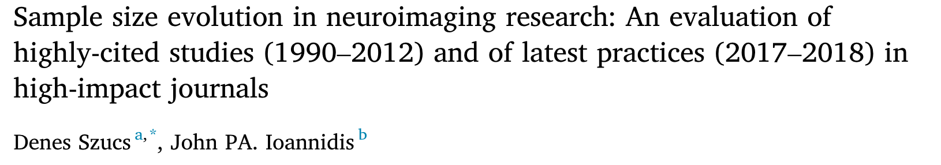
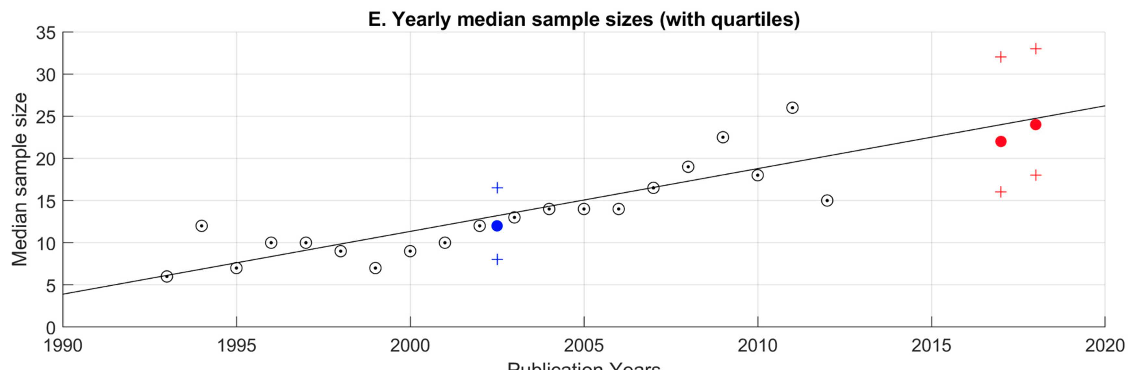
Is it getting better?
Maybe, slowly
https://www.vox.com/future-perfect/21504366/science-replication-crisis-peer-review-statistics

Slide 14
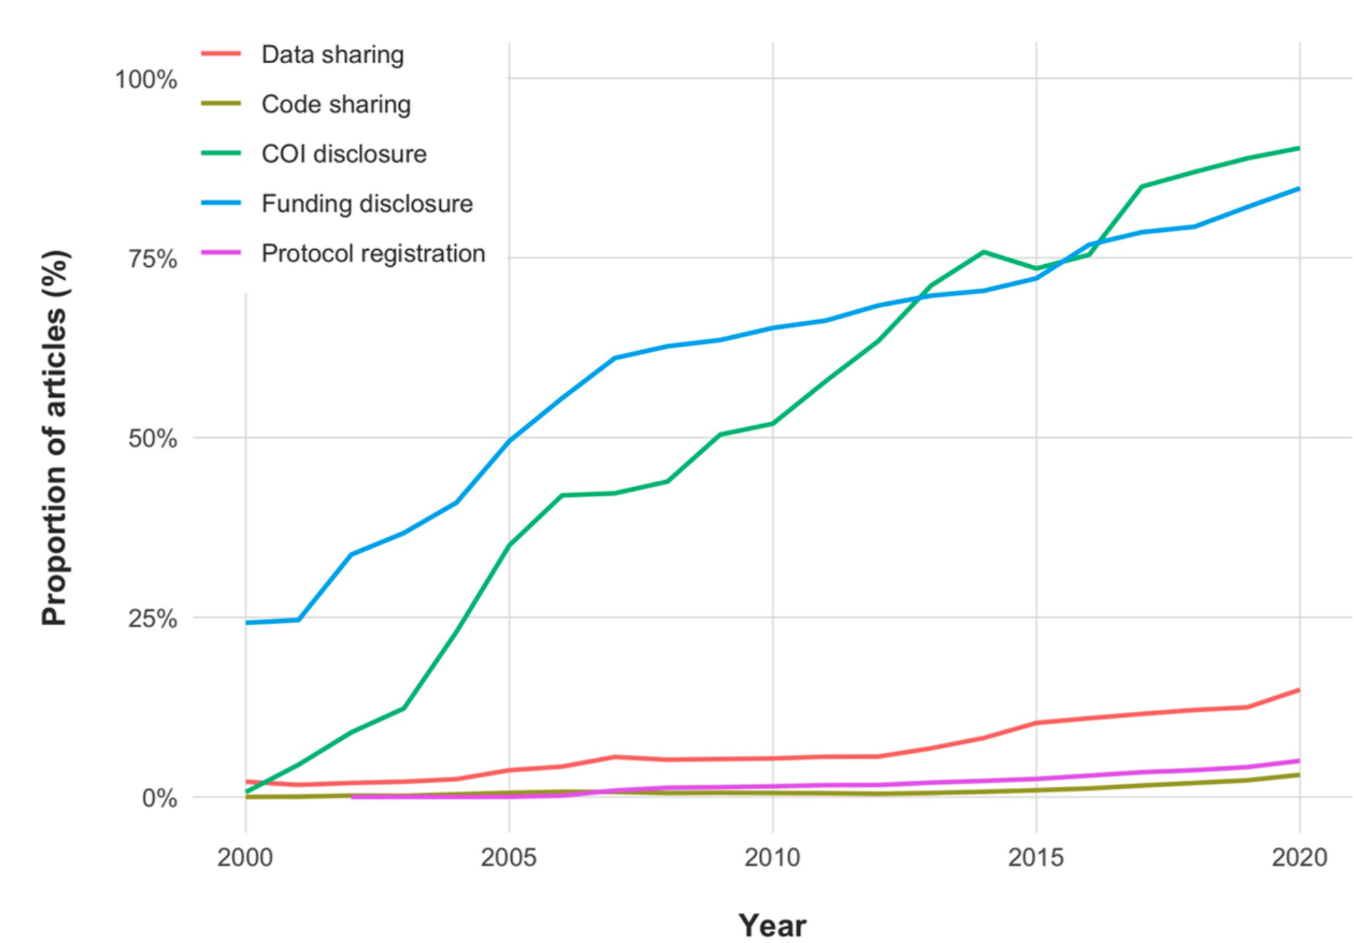
Is it getting better?
Maybe, slowly
Serghiou et al. (2021) Assessment of transparency indicators across the biomedical literature: How open is open?. PLOS Biology https://doi.org/10.1371/journal.pbio.3001107

Slide 15
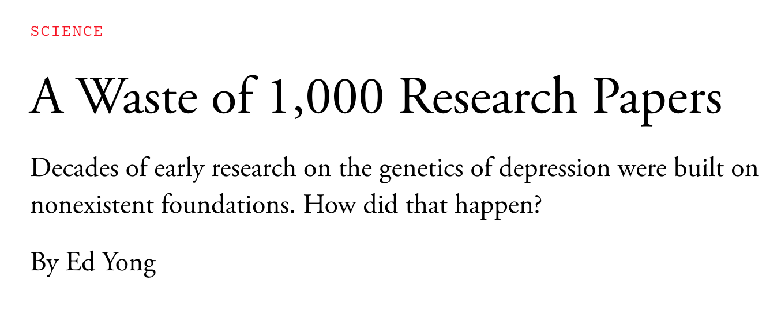


Reproducibility in Mental Health
https://www.theatlantic.com/science/archive/2019/05/waste-1000-studies/589684/
https://doi.org/10.1176/appi.ajp.2018.18070881

Slide 16
Reproducibility in Mental Health
A 1996 study of 1,000 subjects claimed that a candidate gene, SLC6A4, was found to influence a person’s risk of clinical depression.
17 other candidate genes were subsequently linked to depression risks, using similar methods and sample sizes
Together, over 1,000 papers were published on these genes.
A 2019 study using 10s to 100s of thousands of subjects showed none of the 18 genes were related to depression risk.
“How on Earth could we have spent 20 years and hundreds of millions of dollars studying pure noise?” – Matthew Keller, lead author
https://www.theatlantic.com/science/archive/2019/05/waste-1000-studies/589684/
https://doi.org/10.1176/appi.ajp.2018.18070881

Slide 17
Poll Question #4
Scientists are pretty good at predicting (guessing) which findings will be reproducible in published papers.
True
False

Slide 18
Poll Question #4
Scientists are pretty good at predicting (guessing) which findings will be reproducible in published papers.
True
False

Slide 19
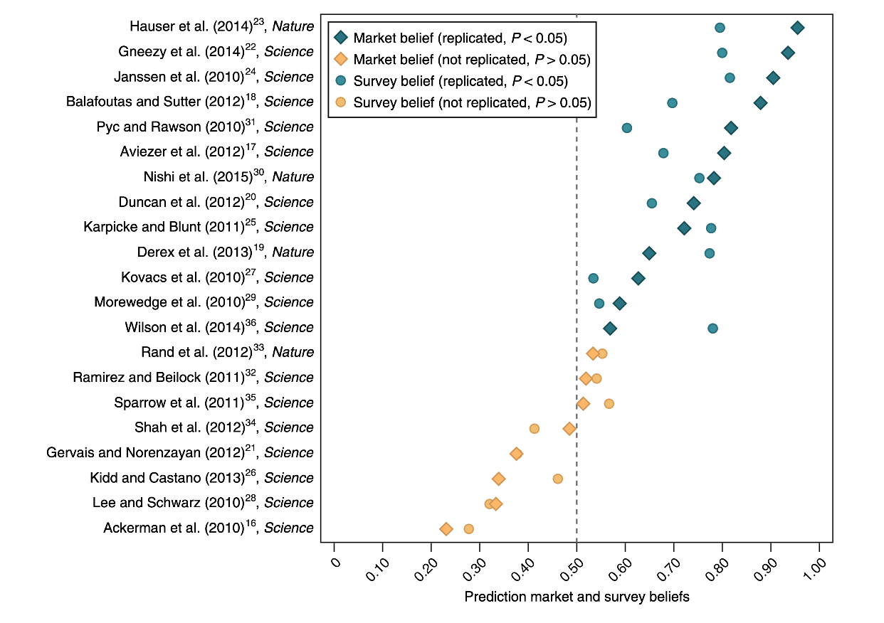
Unreproducible results are predictable
https://doi.org/10.1038/s41562-018-0399-z

Slide 20
Poll Question #5
Which factor is the most predictive of findings that will be reproducible?
Large effect size
Published in prestigious journal
Large sample size
Well respected lab/institution
Transparency/availability of data/code/methods

Slide 21
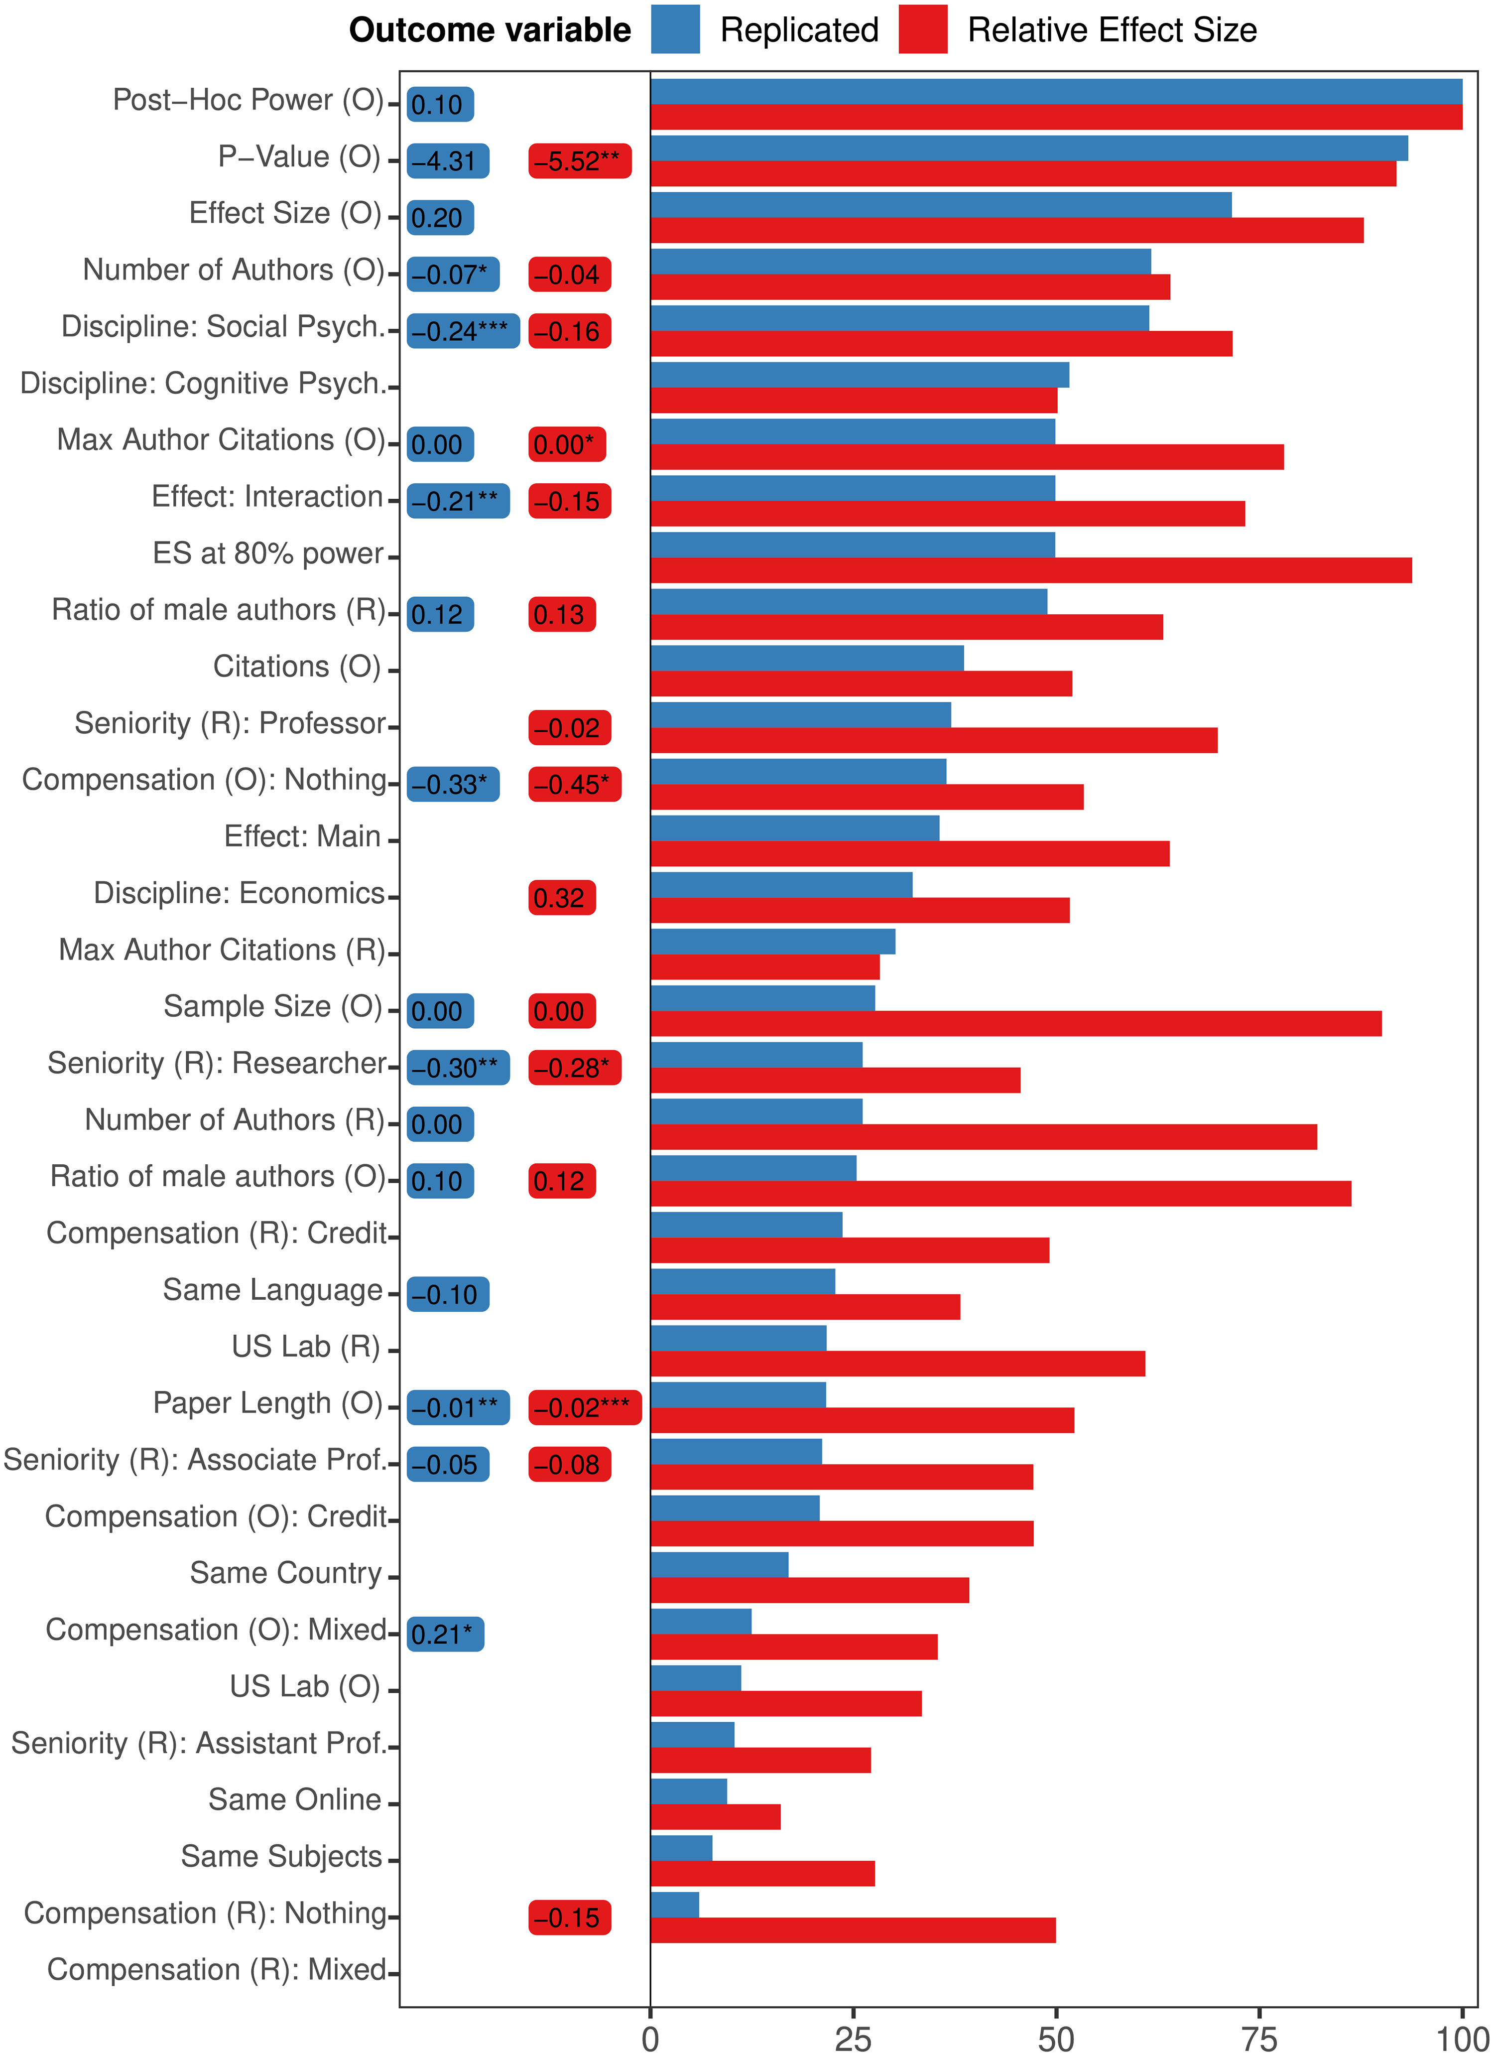
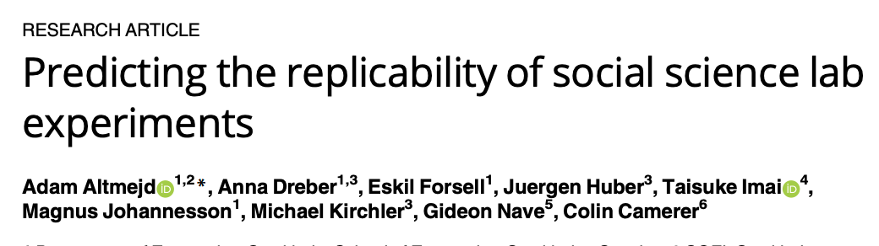
What factors are predictive of reproducibility?
https://doi.org/10.1371/journal.pone.0225826

Slide 22
What features correlate with unreproducible findings?
Large effect size
Published in prestigious journal
Large sample size
Well respected lab/institution
Transparency/availability of data/code/methods

Slide 23
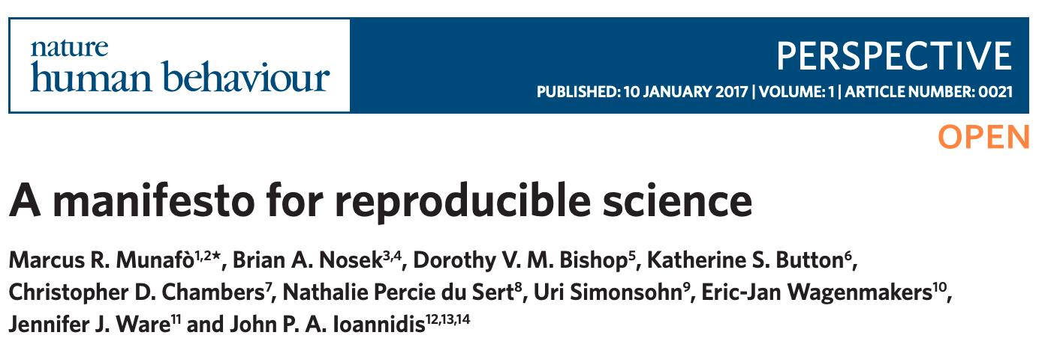
What features correlate with unreproducible findings?
Transparency/availability of data/code/methods
Well respected lab/institution?
Isolated and siloed researchers are more likely to produce irreproducible results (many eyeballs)
However, high ranking labs may be blindly trusted and subject to less scrutiny.
Groupthink is common in science. Creative, out-of-the-box ideas can come from labs outside the establishment.

Slide 24
Summary so far (Part 1)
The number of unreproducible findings in the biomedical literatures remains alarmingly high
Some irreproducibility is just part of science, but the majority is preventable
There has been some progress in changing norms and behavior, but it is slow
Questions before Part 2?

Slide 25
Part 2: If all biomedical science has been mired in a reproducibility crisis for nearly 20 years, is there anything a data science minded summer intern can do about it?
Yes!
In fact, trainees are the key to fixing this mess!

Slide 26
How can you improve reproducibility?
Pre-registration
Planning for data sharing
Version control & code sharing (git/github)
Dealing with errors (Unit tests / continuous integration)
Making your code reusable (Containers)
Reporting and dissemination (Pre-prints & checklist)

Slide 27

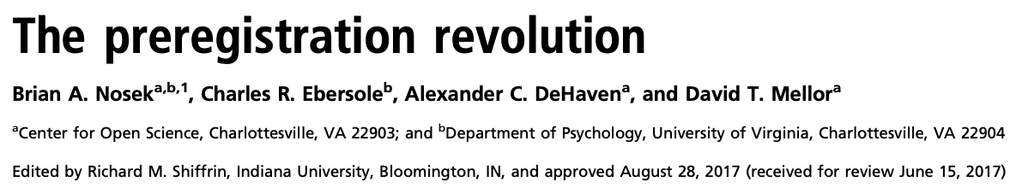
Pre-registration
Pre-registration is the simple process of making a record of experimental predictions
It does not prohibit or prevent exploratory research
It does help the investigator and the reader distinguish between predictions and “postdiction” (HARKing)
Pre-registration also combat publication bias
https://doi.org/10.1073/pnas.1708274114

Slide 28
Planning ahead for Data Sharing
Human subjects: Ensure your protocol has acceptable data sharing language:
https://open-brain-consent.readthedocs.io
When designing, collecting, and analyzing consult with standards documents:
Enhancing Quality and Transparency of Health Research (EQUATOR) http://www.equator-network.org
Best Practices in Data Analysis and Sharing in Neuroimaging using MRI (COBIDAS) http://dx.doi.org/10.1101/054262
Think about which repository might be best for sharing your data. What structure/format will it require?
https://www.nlm.nih.gov/NIHbmic/nih_data_sharing_repositories.html

Slide 29



Version Control
Version control systems allows you to:
Store all your analysis in a central repository
Keep a history of “snapshots” of your evolving analysis
Quickly switch between different versions of your analysis
Adopt and modify code from other scientists
Collaborate

Slide 30
Poll Question #6
Studies have shown that computer code written by scientists has an average of:
less than 1 defect per 1000 lines of code
1-10 defects per 1000 lines of code
10-20 defect per 1000 lines of code
Greater than 20 defects per lines of code

Slide 31
Poll Question #6
Studies have shown that computer code written by scientists has an average of:
less than 1 defect per 1000 lines of code
1-10 defects per 1000 lines of code
10-20 defect per 1000 lines of code
Greater than 20 defects per lines of code

Slide 32
Coding Errors are a fact of life
One 2003 study looked at coding errors from professional software developers make an average of 1 to 7.5 defects per lines of code.
Other estimates put the number at 10 to 50 defects per 1000 lines of code
It’s not a question of whether your code has errors (it does), it’s a question of when you find them and how they impact your results
https://reproducibility.stanford.edu/coding-error-postmortem/

Slide 33
Coding Errors are a fact of life
One 2003 study looked at coding errors from professional software developers make an average of 1 to 7.5 defects per lines of code.
Other estimates put the number at 10 to 50 defects per 1000 lines of code
It’s not a question of whether your code has errors (it does), it’s a question of when you find them and how they impact your results
https://reproducibility.stanford.edu/coding-error-postmortem/

Slide 34
Typical approach to code testing in science
Write some code
Run code on some of your data
Debug code until the output looks reasonable
Repeat!
“The first principle is that you must not fool yourself and you are the easiest person to fool.” –Richard Feynman, 1974

Slide 35

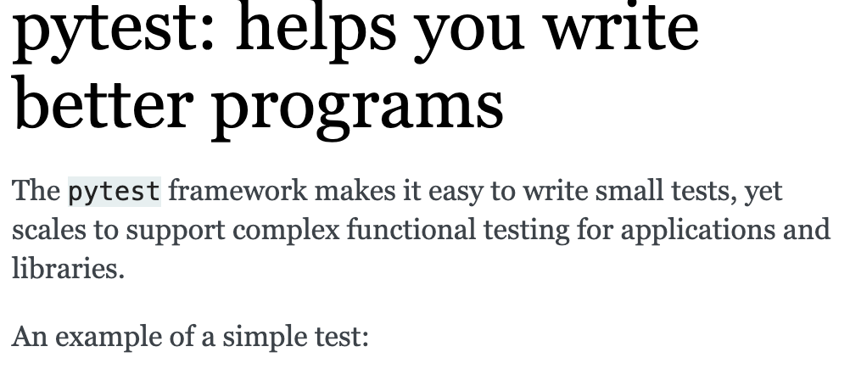
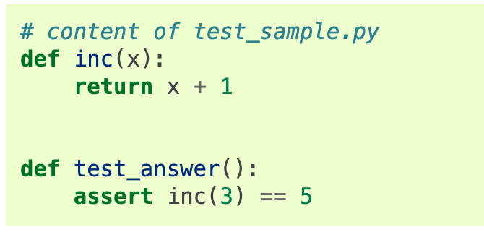
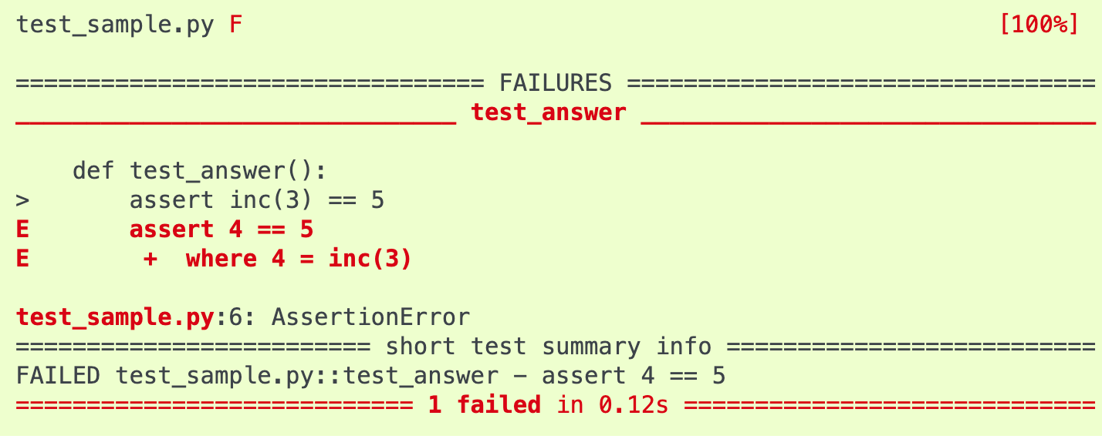
Testing your code

Slide 36
Testing your code
A basic pytest tutorial for data science https://github.com/poldrack/pytest_tutorial
Ask github to run your tests every time you commit (continuous integration)
Automated assessment how much of your code has been tested (pip install coverage)
Unit tests in R https://towardsdatascience.com/unit-testing-in-r-68ab9cc8d211

Slide 37
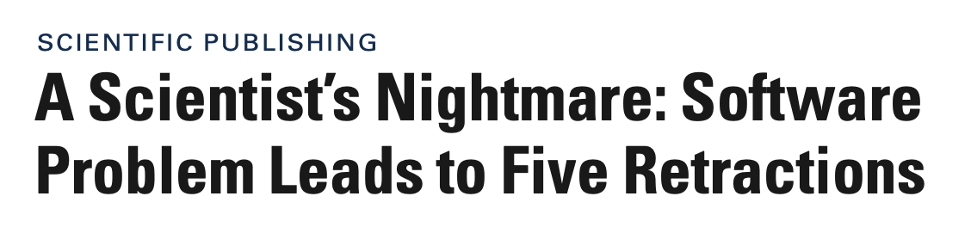
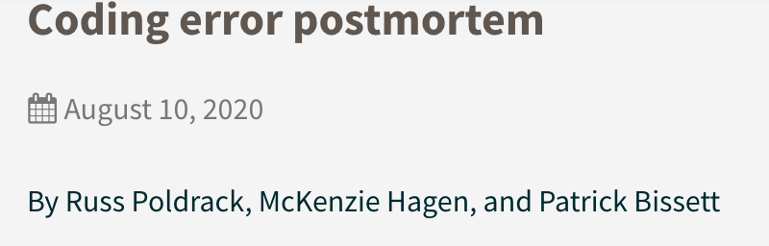
Dealing with errors
Even in the best labs, sometimes errors slip through
In 2007, Chang and coauthors retracted five previously published papers describing the structures of three multidrug transporter proteins after another research group published a widely differing structure, which led to the discovery of a critical bug in the Chang group's custom software tools..
“We had posted a preprint describing some issues that we had identified with the stop-signal task in the ABCD Study, along with the code used for all of the analyses. The ABCD stop-signal team performed a detailed review our code and notified us of an error in the code that resulted in inaccurate estimation of one of the basic behavioral measures on the task”

Slide 38

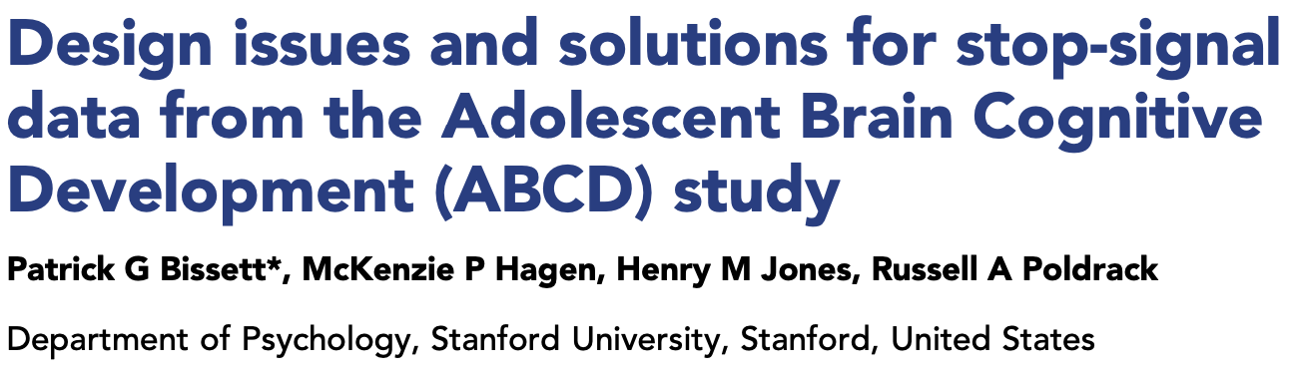
Dealing with errors
Even in the best labs, sometimes errors slip through
Since then, Chang has published several papers in the field of structural biology, and has been awarded a EUREKA grant, "for exceptionally innovative research projects that could have an extraordinarily significant impact on many areas of science," from the NIH and is a full professor at USCD.

Slide 39
Dealing with errors
Even in the best labs, sometimes errors slip through
Sharing code is critical for discovering error. Don’t let embarrassment about ugly code stop you from sharing.
Own your mistakes and do what’s necessary to correct them. Good PIs will applaud you for it.
Making errors and correcting them is part of science.
Normalizing errors is a critical step in addressing the reproducibility crisis.
Never mock or jeer another person’s code, no matter how sloppy.

Slide 40
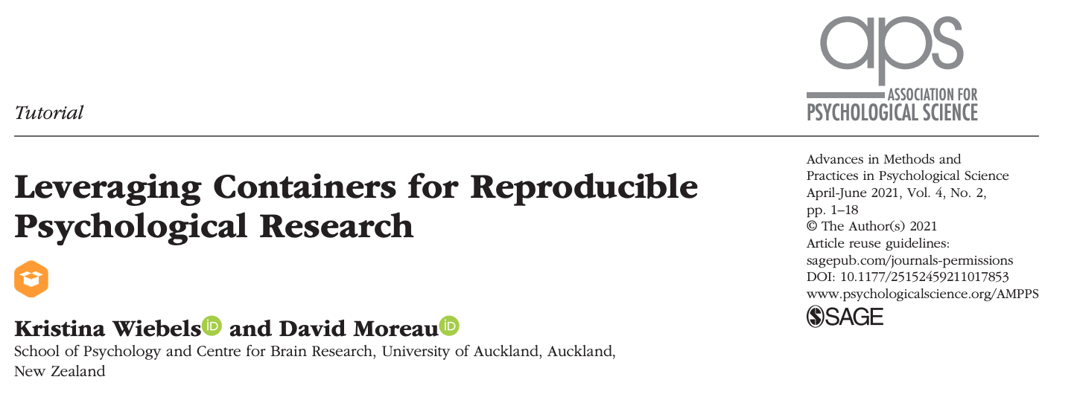
Reproducible workflows with Containers
Containers (with Docker or Singularity) allow packaging up all code and dependencies to ensure that analyses run reliably across a range of operating systems and software versions. https://doi.org/10.1177/25152459211017853
Containers at NIH are easy! https://hpc.nih.gov/apps/singularity.html

Slide 41


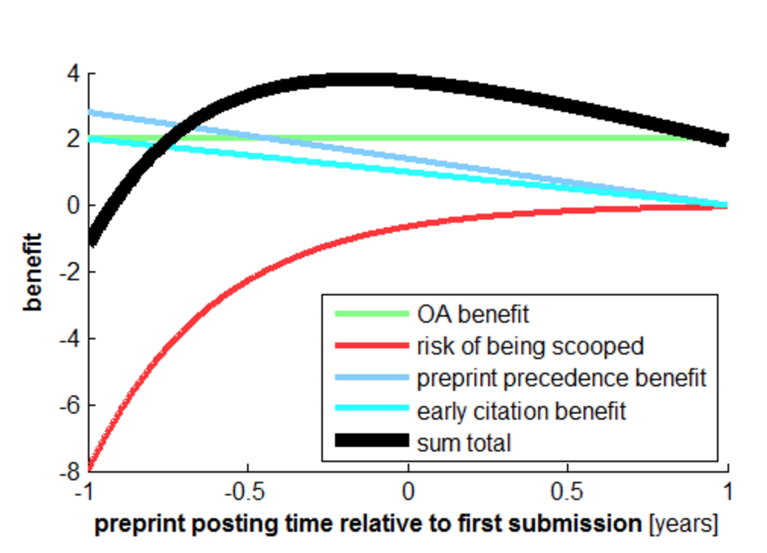
Preprint posting
Benefits:
Open access
Catch errors
Earlier citation
Earlier precedence, prevent scooping
Speed and improve final submission
Kriegeskorte (2016) DOI:10.15200/winn.145838.88372

Slide 42
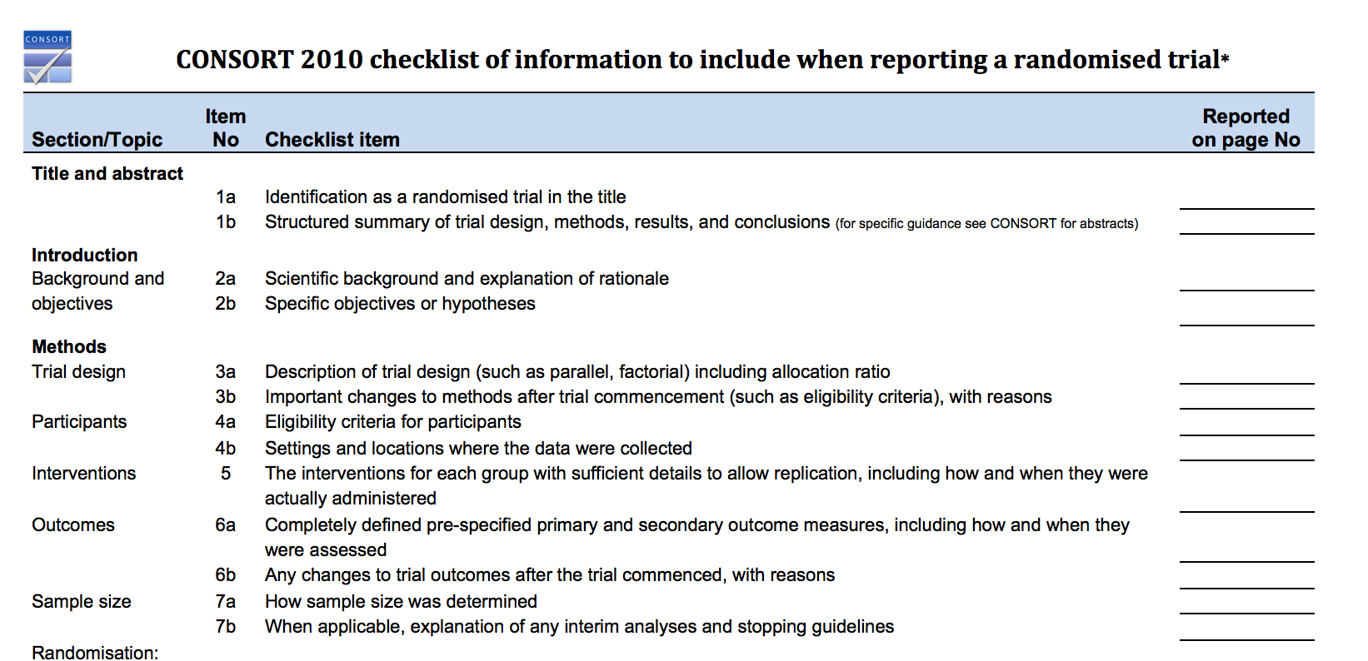
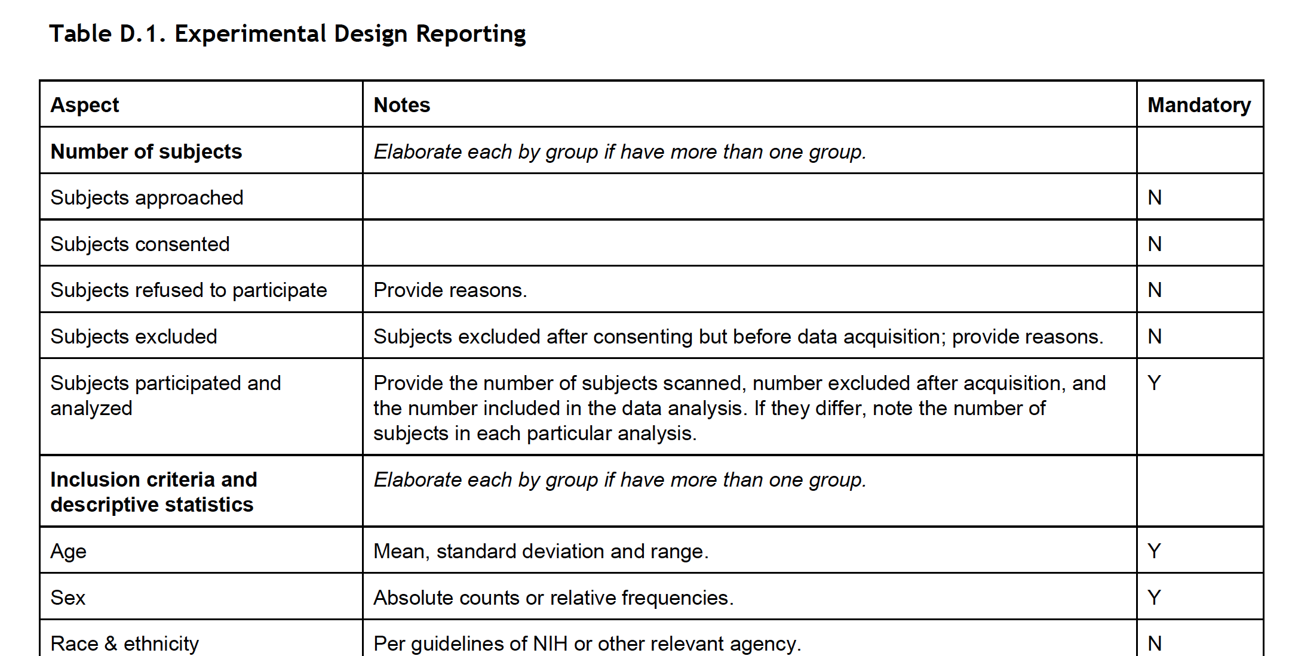
Standards – EQUATOR & COBIDAS
Checklists

Slide 43
Take Homes
A large fraction of the people listening to this will author an unreproducible finding
Some of reproducibility is just part of science, but a much larger fraction is preventable
YOU can influence your PI to do more reproducible science:
Ask to pre-register the study
Make your code available, readable, re-runnable
Plan for coding errors and include test to catch them
Don't be embarrassed of your code and don't mock others
Report your work thoroughly using checklists and broadly using pre-print servers

Slide 44
Thanks! See online slides for more URLs and references: https://github.com/agt24 Questions?
http://cmn.nimh.nih.gov/dsst

Slide 45
Extra Slides

Slide 46
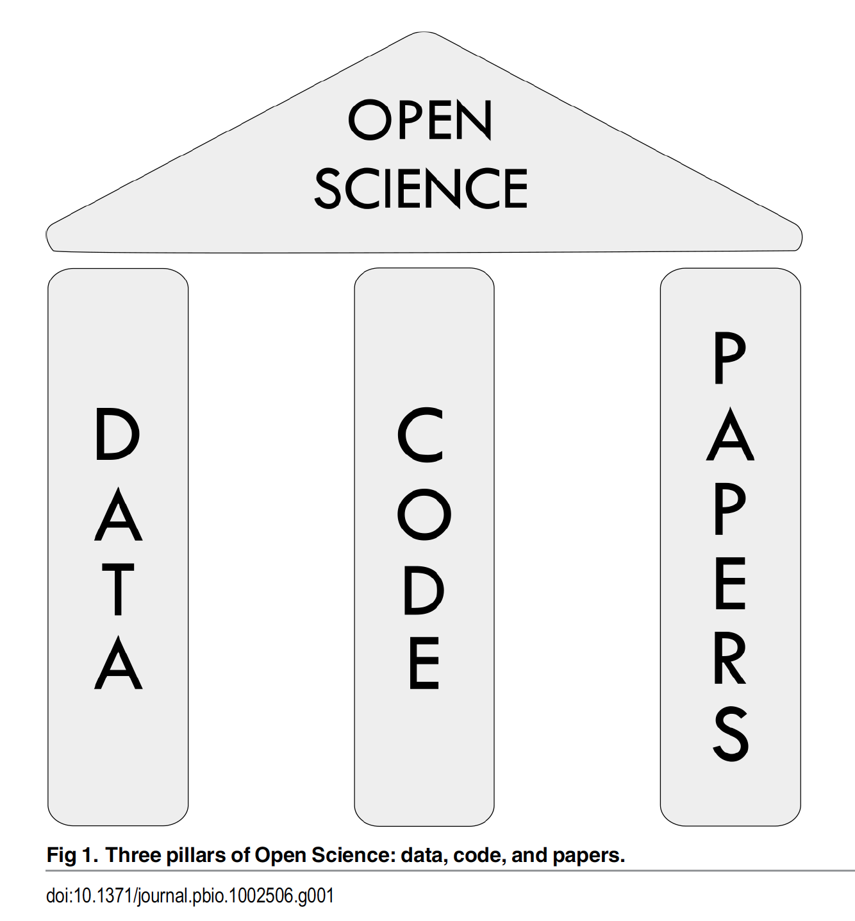
What is Open Science?

Slide 47
What does Reproducibility even mean?
Varies by field
Political Science, Economics: The terms are used with no distinction between them.
Statistics & Most Biomedical Research: “Reproducibility” refers to instances in which the original researcher's data and computer codes are used to regenerate the results, while “replicability” refers to instances in which a researcher collects new data to arrive at the same scientific findings as a previous study.
Microbiology, Immunology, Computer Science: “Reproducibility” refers to independent researchers arriving at the same results using their own data and methods, while “replicability” refers to a different team arriving at the same results using the original author's artifacts. https://www.ncbi.nlm.nih.gov/books/NBK547546/ https://arxiv.org/pdf/1802.03311.pdf

Slide 48
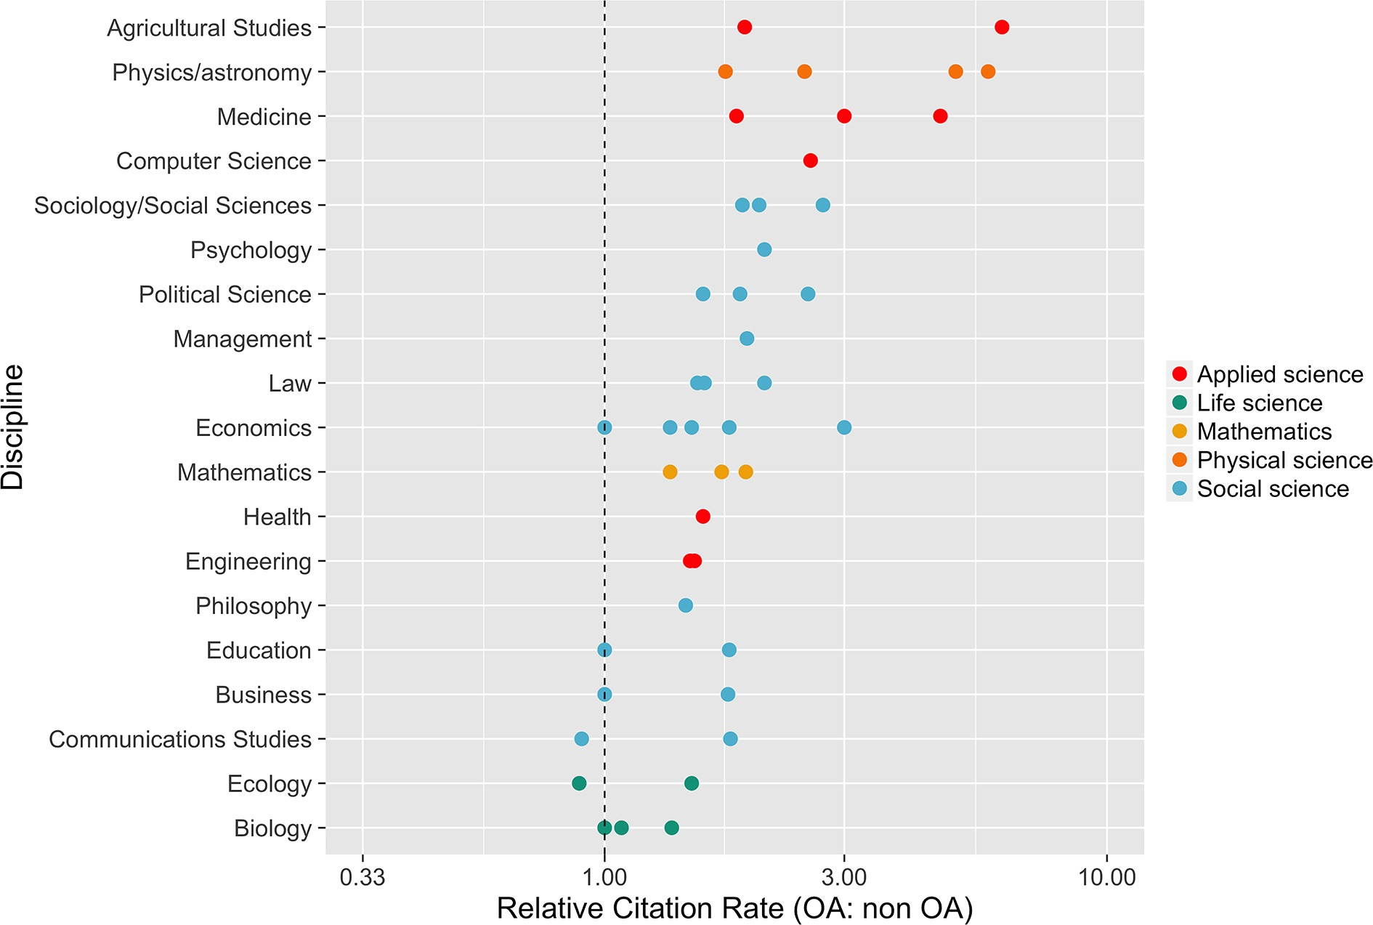
Open Access Open access publication are cited more
https://elifesciences.org/content/5/e16800%20
mean citation rate of OA articles divided by mean citation rate of non-OA articles

Slide 49
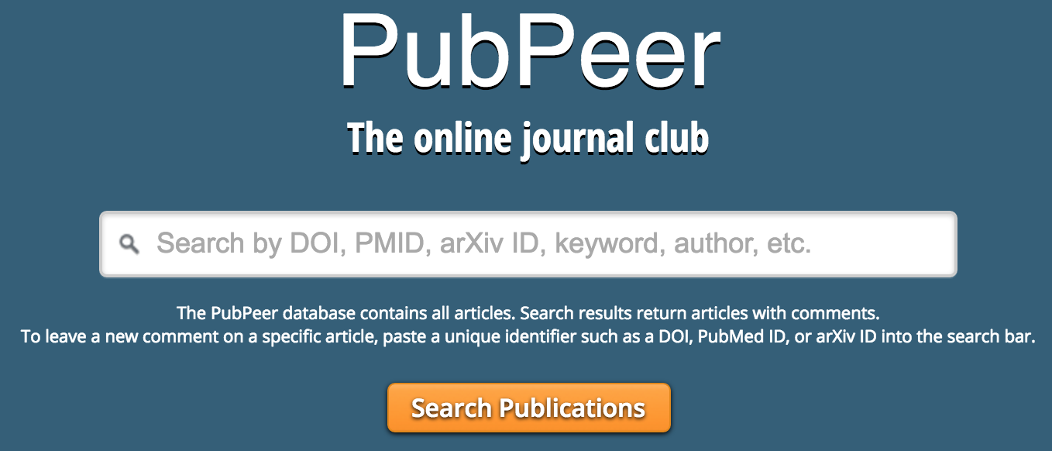


Open Review
Public discussion of pros and cons of submission
Optional anonymity
Prevent low-quality and or biased review

Slide 50
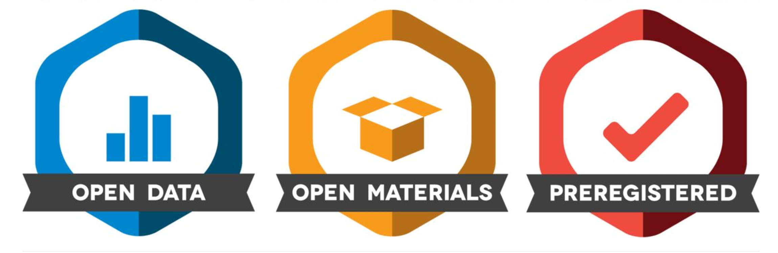
Incentives: Badges

Slide 51
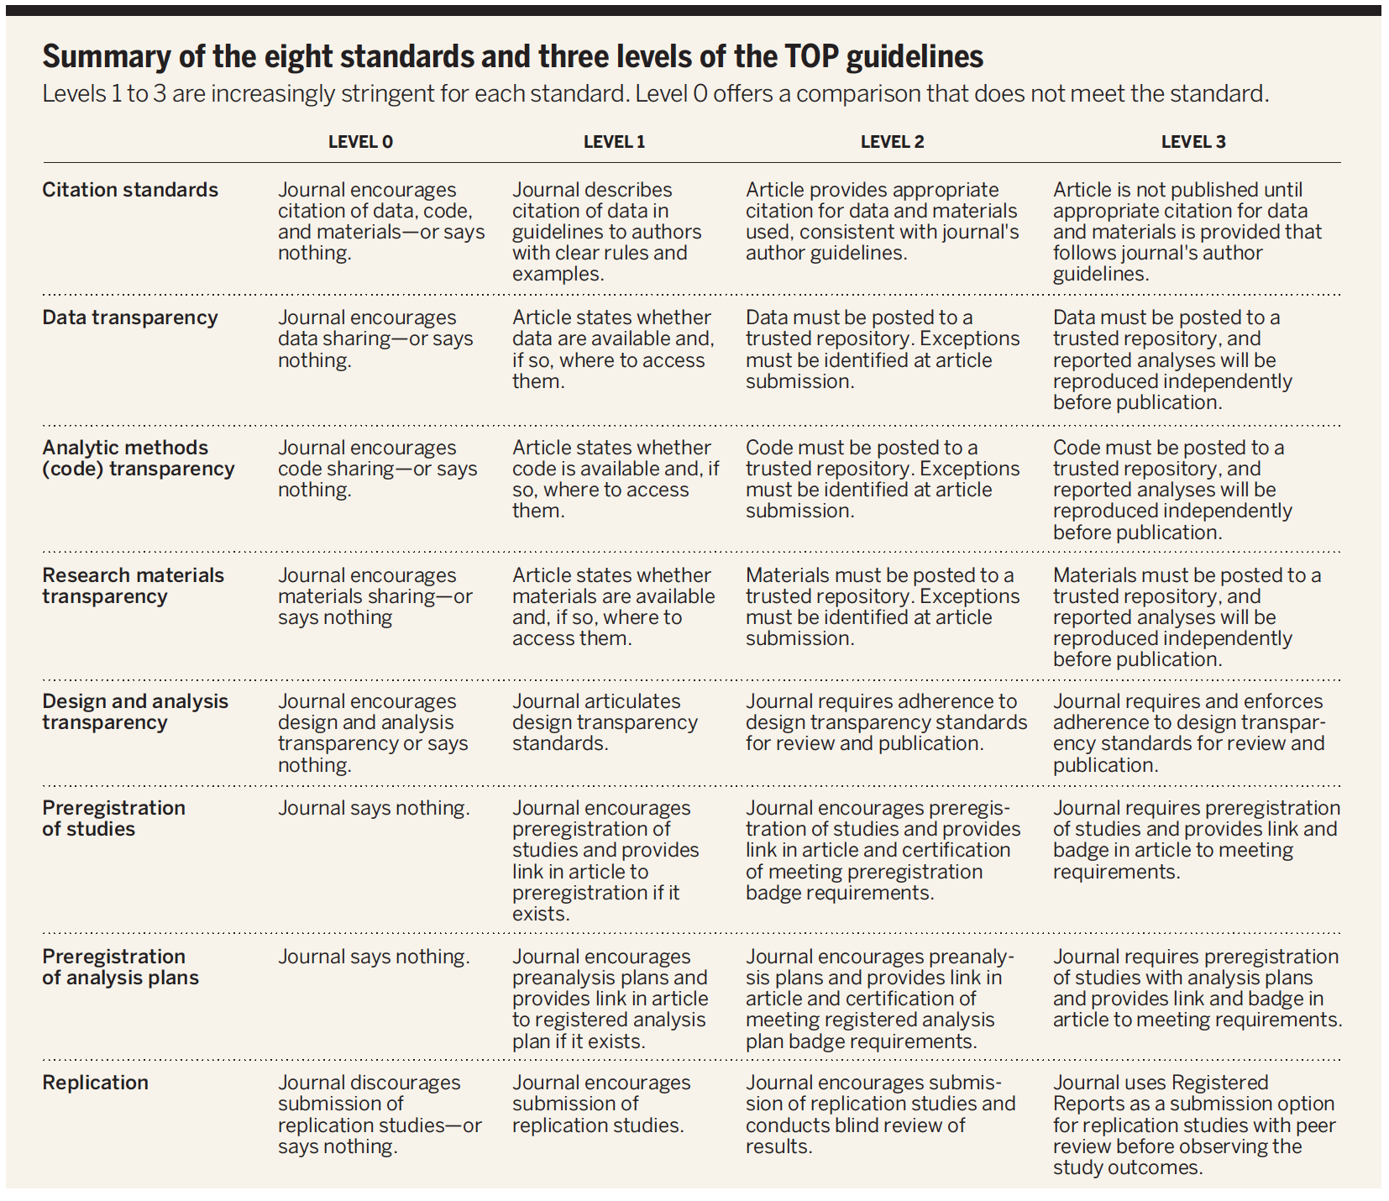
How to be Open – Choose your battles Be open when you can, as you can

